Slide 1
Analyzing Fire and EMS Incidents for Oxford Fire Department
RJ Worrall, Lily Douthat, Anton Martinez, Mirza Baig
4/7/2026
Miami University
STA 475 Senior Capstone Project

Slide 2
Project Overview
Understand the nature of the data.
Discover trends/causes of overlapping calls within the Oxford Fire Department EMS and Fire call data.
Analyze the different maps of the data.

Slide 3
Project Objective
How can the Oxford Fire Department improve staffing and resource allocation?
How often do overlapping calls occur?
What qualities do overlapping calls tend to have?
Map out results using interactive visualizations and maps

Slide 4
Initial Data Preprocessing
Performed in Python; Pandas and NumPy libraries.
Read and combined EMS and Fire datasets.
Columns that initially didn’t merge were put together for cleaner analysis.
Aggregation of the initially missing cleared times for EMS calls.
Necessary to determine overlapping calls.

Slide 5
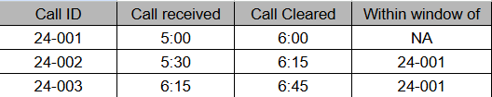
Initial Data Preprocessing
New column for overlapping data: shows the id of the previous call it overlaps.
If two or more calls overlap the same one, they all hold the key of the first.
Overlap: when a call happened in the window between a previous call being received and 30 minutes after it was cleared.

Slide 6
Other Data Manipulation
Converted dispatch, arrival, and cleared times to datetime
Extracted longitude from location
Filtered invalid ages (0 or >110)

Slide 7
Exploratory Data Analysis (EDA)
Questions to answer:
What are the general characteristics of emergency and fire calls? In terms of age, incident type, location category (on campus, Oxford city, etc.)
What times of day, time of week, time of year, shift has the highest risk of fire/emergency?
How often do false alarms occur? What trends can we find in this subset of data?
How much variation is there in response times?

Slide 8
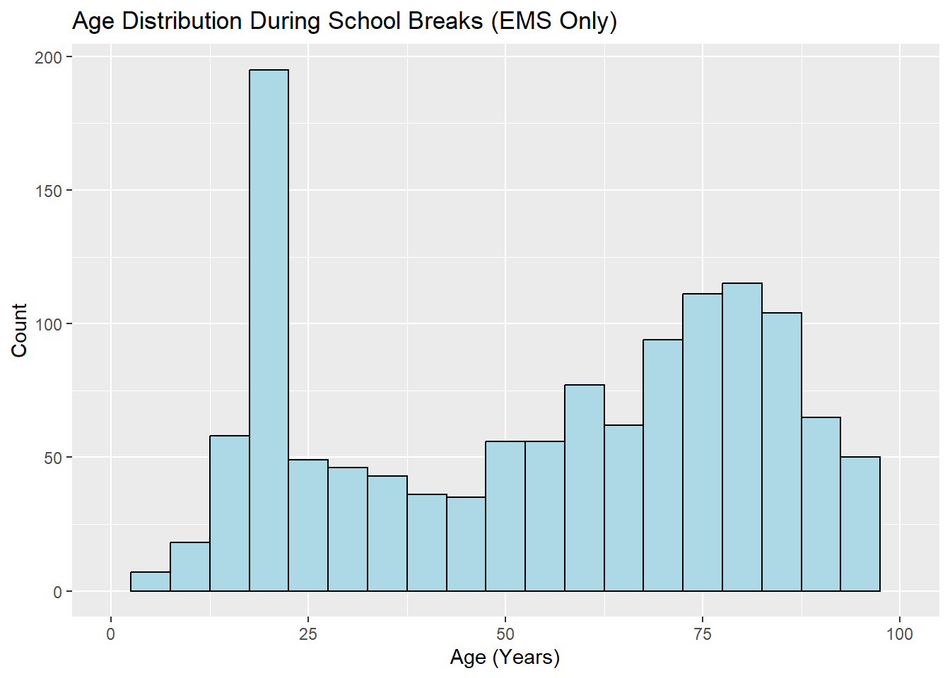
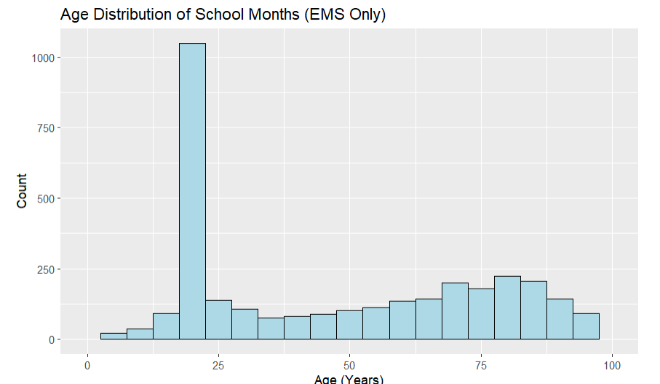
EDA: General Characteristics
Age Distribution Analysis

Slide 9
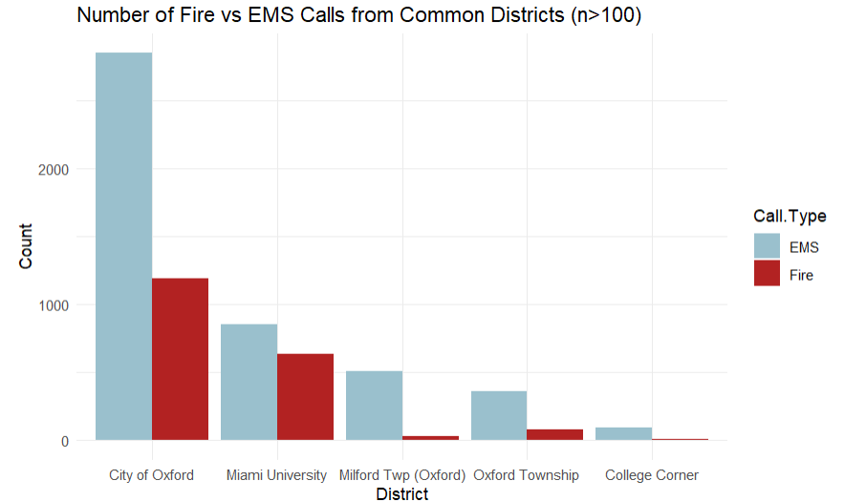
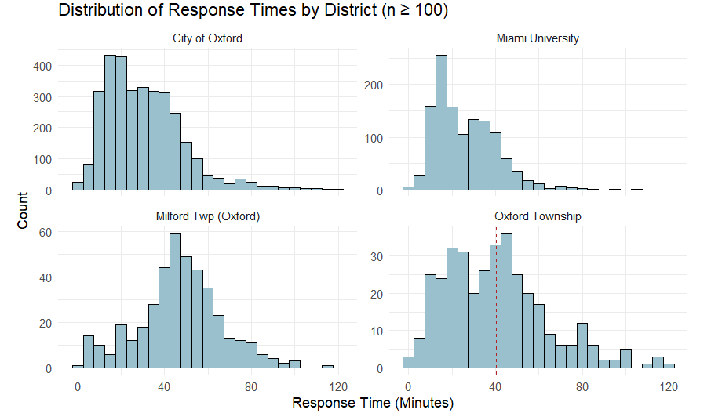
EDA: General Characteristics Cont.
District Analysis

Slide 10
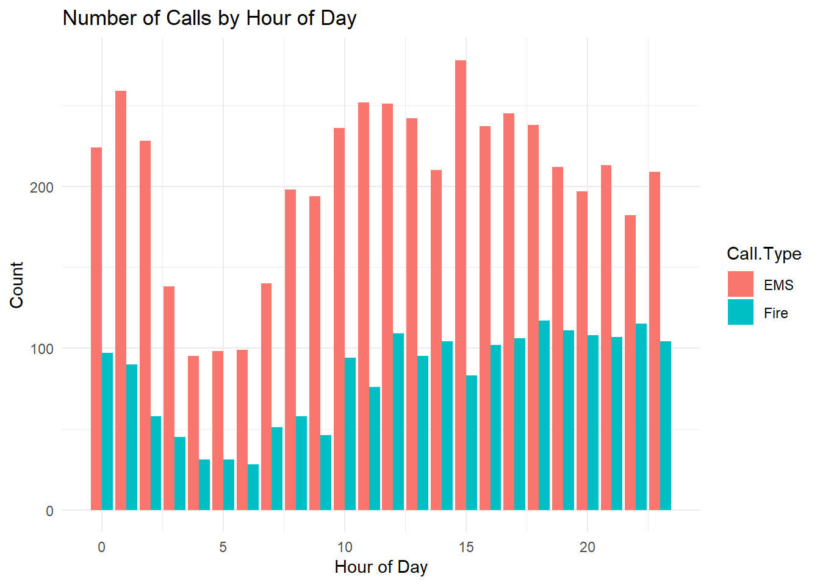
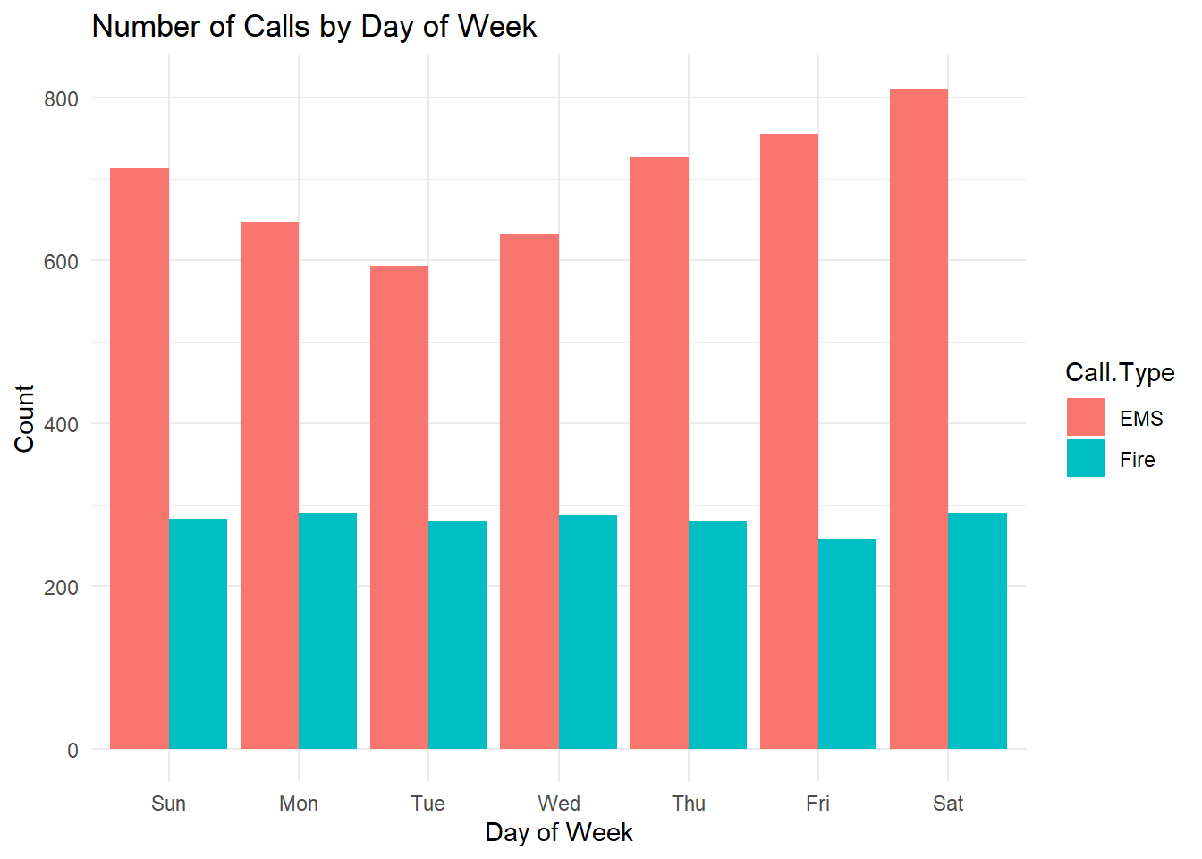
EDA: General Characteristics Cont.
Time Analysis

Slide 11
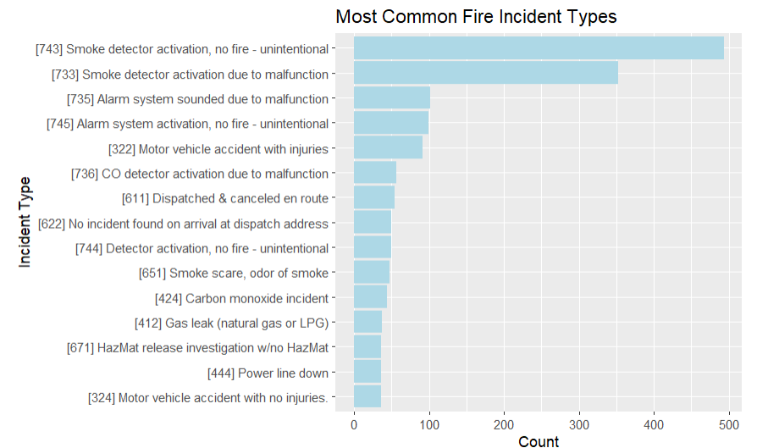
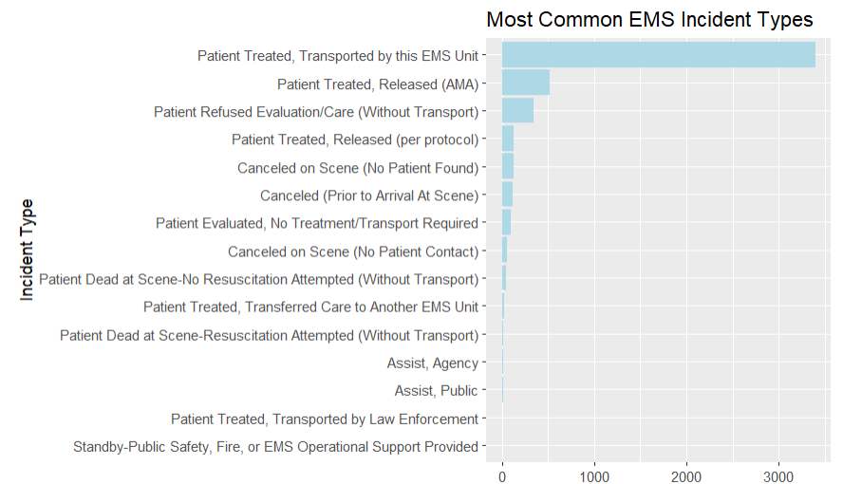
EDA: General Characteristics Cont.
Incident Type Analysis

Slide 12
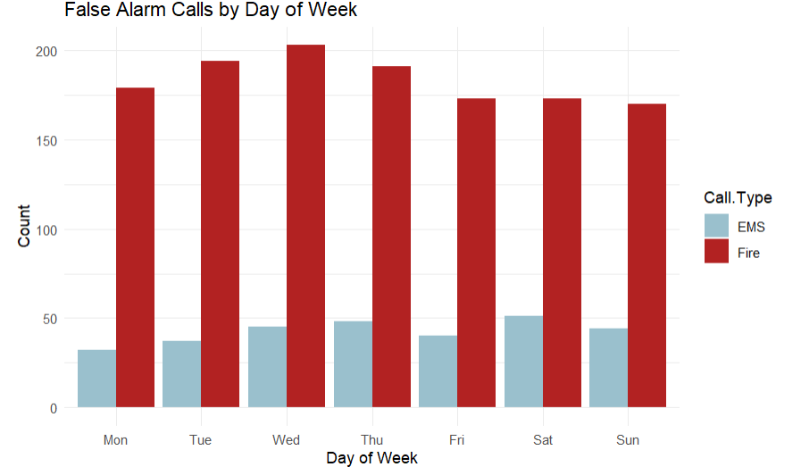
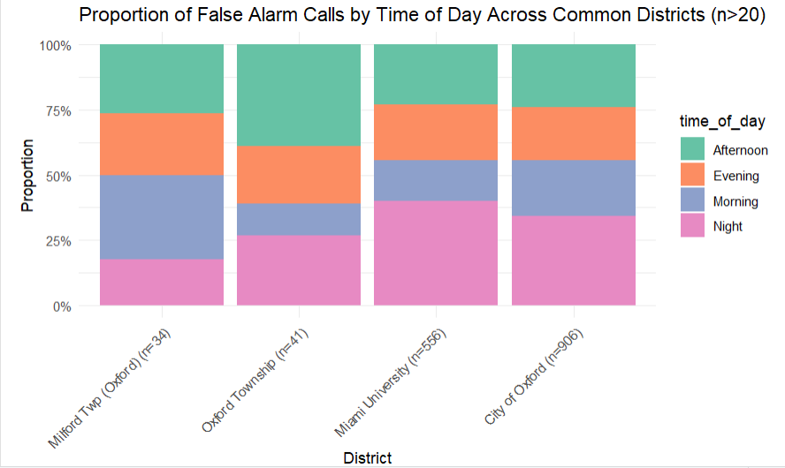
EDA: Deep Dive
False Alarms Analysis

Slide 13
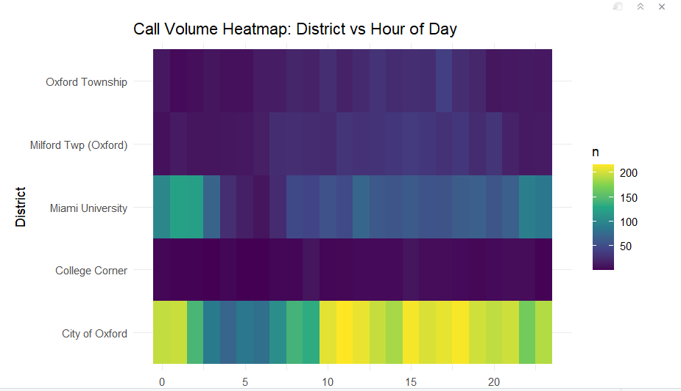
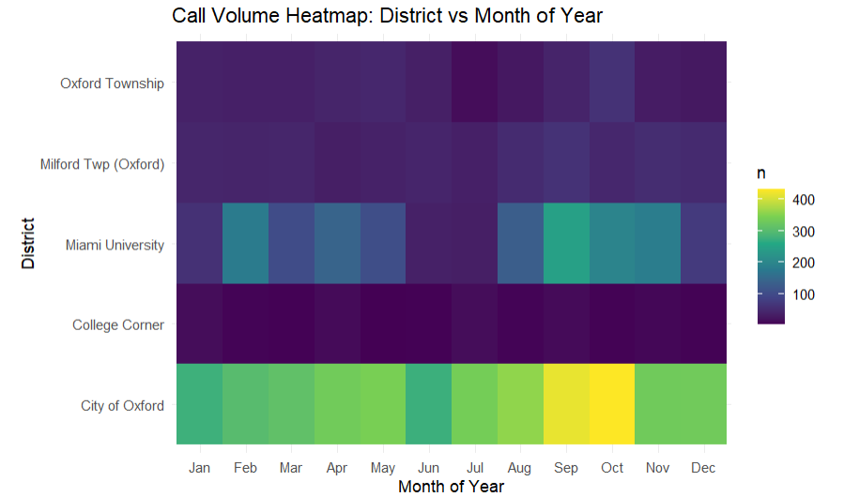
EDA: Deep Dive Cont.
Call Volume by District and Time

Slide 14
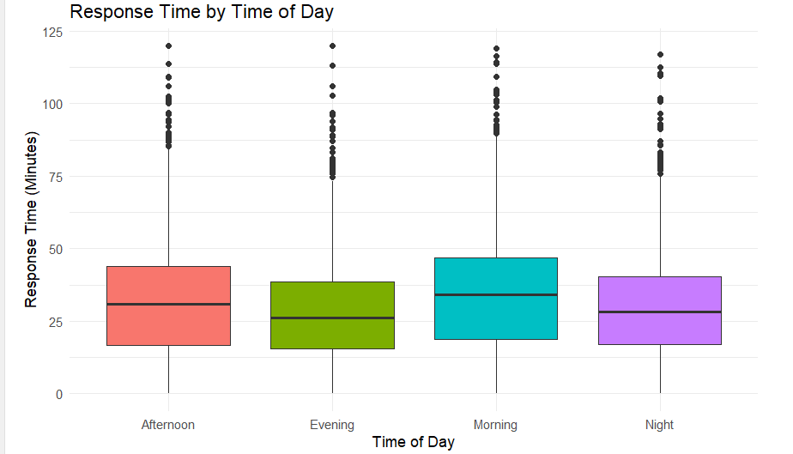
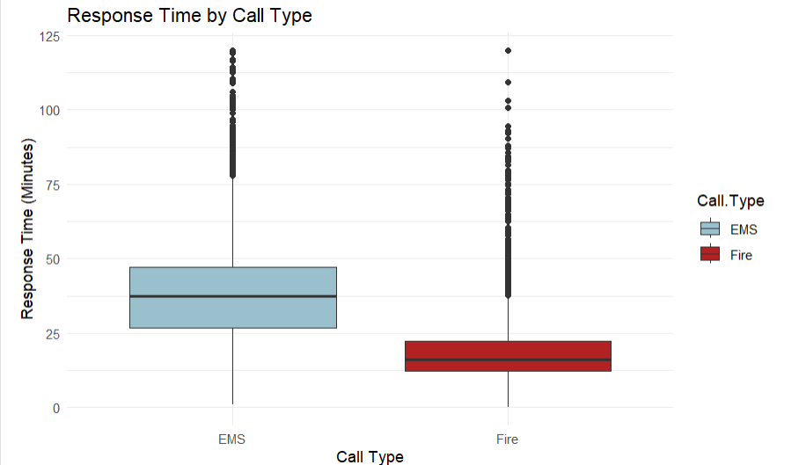
EDA: Deep Dive Cont.
Response Times by Time of Day and Call Type

Slide 15
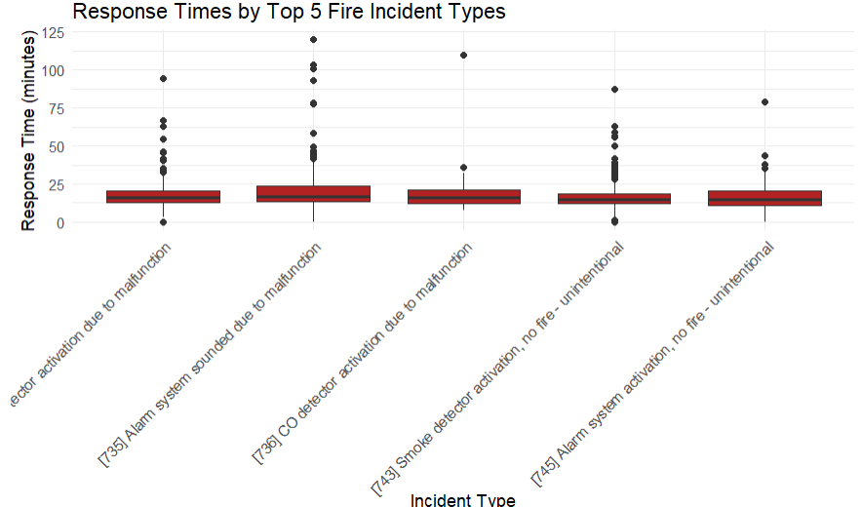
EDA: Deep Dive Cont.
Response Time by Fire Call (5 most common)
Left to Right:
Smoke detector malfunction
Alarm malfunction
CO detector malfunction
Accidental smoke detector
activation
Accidental alarm activation

Slide 16
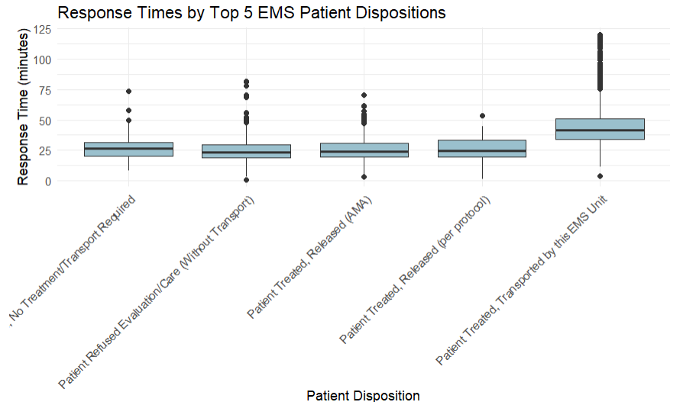
EDA: Deep Dive Cont.
Response Time by EMS Call (5 most common)
Left to Right:
No treatment required
Patient refused care
Patient treated, released (AMA)
Patient treated, released (protocol)
Patient treated, transported by unit

Slide 17
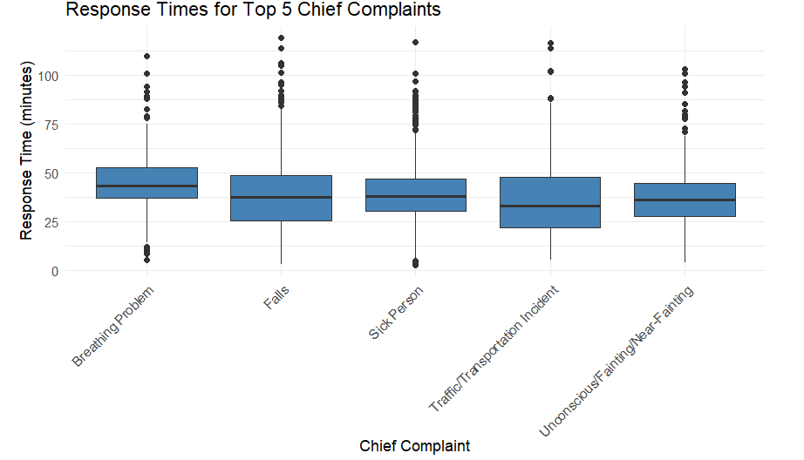
EDA: Deep Dive Cont.
EMS Response Times by Patient Complaint
Left to Right:
Breathing problem
Falls
Sick person
Traffic incident
Unconscious/fainting

Slide 18
EDA: Major Takeaways
City of Oxford and Miami University are the most common incident locations
Calls are most common during evening/nighttime, weekends, and early fall months (Sept, Oct)
EMS calls have longer response times on average compared to fire
Among common EMS call complaints/illnesses, response times are pretty consistent around ~45 minutes.

Slide 19
Definition of Overlapping Calls
Calls considered active from dispatch until last unit cleared
Added 30-minute buffer for report writing, restocking, and returning to service
A call is considered overlapping if another call occurs during this window

Slide 20
How Often Do Overlapping Calls Occur?
Total calls: 5317
Overlapping calls: 2123
Overlap rate: 39.93 %

Slide 21
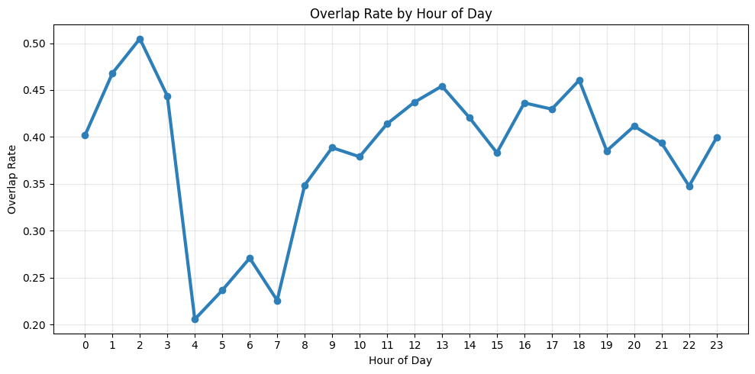
When Do Overlapping Calls Happen Most Often?
Highest overlap early morning and evening
Lowest overlap around early morning hours (4-6 AM)

Slide 22
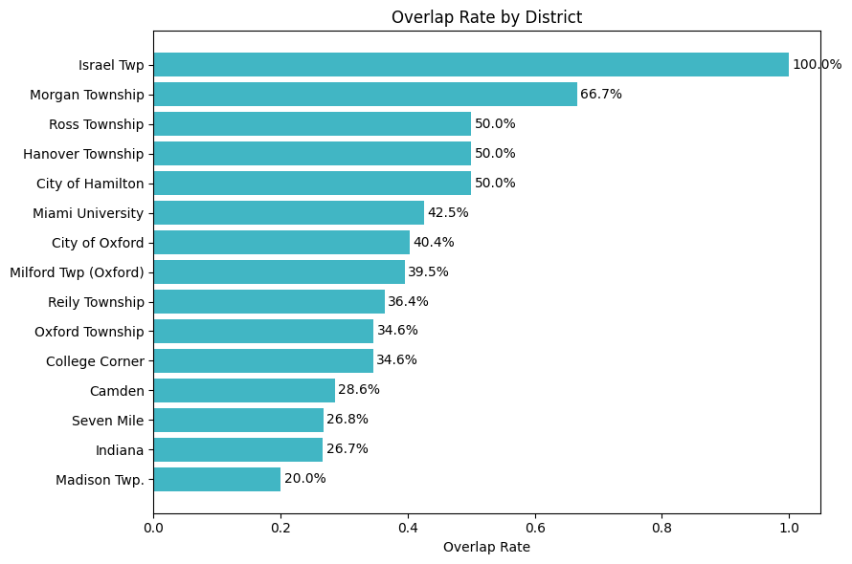
Overlapping Calls by District
Some districts experience higher overlap rates than others
Israel Township and Morgan Township show the highest rates
Likely influenced by distance from station and longer call durations

Slide 23
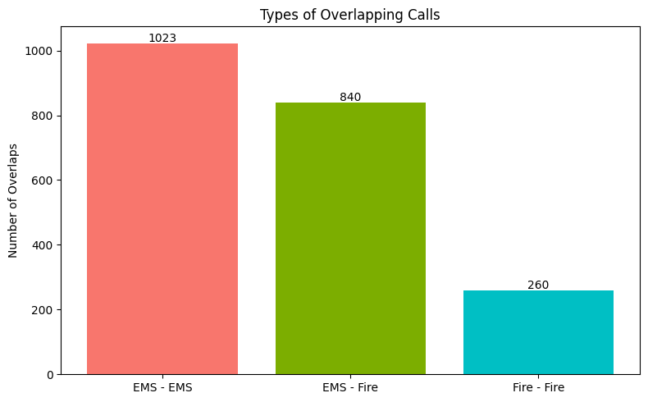
How Often Do EMS and Fire Calls Overlap Each Other?
Overlapping calls were categorized into three groups:
EMS–EMS (medical with medical)
Fire–Fire (fire with fire)
EMS–Fire (medical with fire)

Slide 24
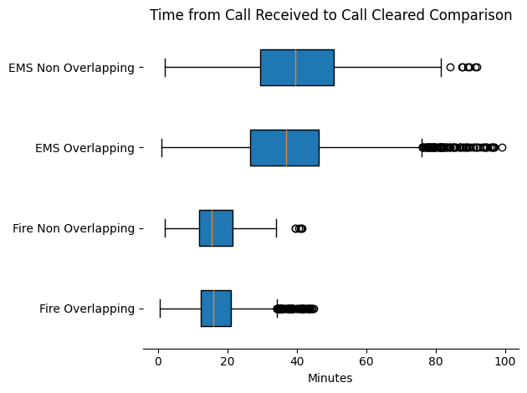
Overlapping Analysis Cont.
Time difference from call received to cleared

Slide 25
What is a Dashboard?
A dashboard is a collection of visuals (charts, graphs, maps) all in one place
It shows important information in a way that is quick to understand
It uses the data sources that we were given to create an interactive visual tool
It allows users to interact with the data (filter, click, explore)

Slide 26
Why Are We Using a Dashboard?
Emergency data is large and hard to interpret in raw form
Visuals make patterns easier to see on the map
Helps identify trends in calls, timing, and workload
Provides us with infinite ways to filter and explore different scenarios
Notes:
3 datasets: Fire incident dataset, EMS incident dataset, EMS “Last Unit Cleared” Dataset

Slide 27
What Is It Used For?
Track call volume over time
Analyze response times
Identify peak hours and busy shifts
Explore overlapping incidents
Compare activity across districts
Explore any combination of these specifications and how they interact with each other

Slide 28
How We Built It
Cleaned and prepared data in R
Combined fire + EMS datasets
Created key variables (like response time & overlap indicators)
Built visuals in Tableau
Interactive Filters Allows filtering by:
Incident type
Location
Season, changes over time
Overlap presence

Slide 29
Accessing the Dashboard
Click the link below to access the dashboard:
Oxford Fire Department Tableau

Slide 30
Dashboard Takeaways
When are the busiest times for calls?
While fire times stay consistent across the week, EMS calls peak on Thursday, Friday, Saturday and Sunday.
All call times see a significant drop in calls from 2 AM - 7 AM.
Are certain districts more active than others?
Further away districts take more time to complete, leading to a high volume of overlapping calls.
Oxford area sees extremely high volumes of calls, so it is natural to see many overlapping calls.

Slide 31
Dashboard Takeaways
When do overlapping incidents happen most often?
Overlapping calls happen most often during midday into early evening (around 3 PM – 7 PM)
Overlaps are more frequent on weekends
Especially higher on Friday evenings and Saturdays
Which shifts handle the highest workload?
Over all 2 years of data, shift 3 has the most calls and the most overlapping calls.

Slide 32
Conclusion and Prospects
Future Opportunities
Develop an automated ETL data pipeline (Extract, Transform, Load)
Automatically pull new call data from the records management system
Refresh the dashboard weekly, monthly, or near real time depending on operational needs
Enable leadership to continuously monitor trends in call demand, staffing strain, and response patterns
Potential Extensions
AI assisted querying or chatbot interface
Additional years of data to track long term operational changes

Slide 33
Questions?

Slide 34
Thank You!

